Slide 1
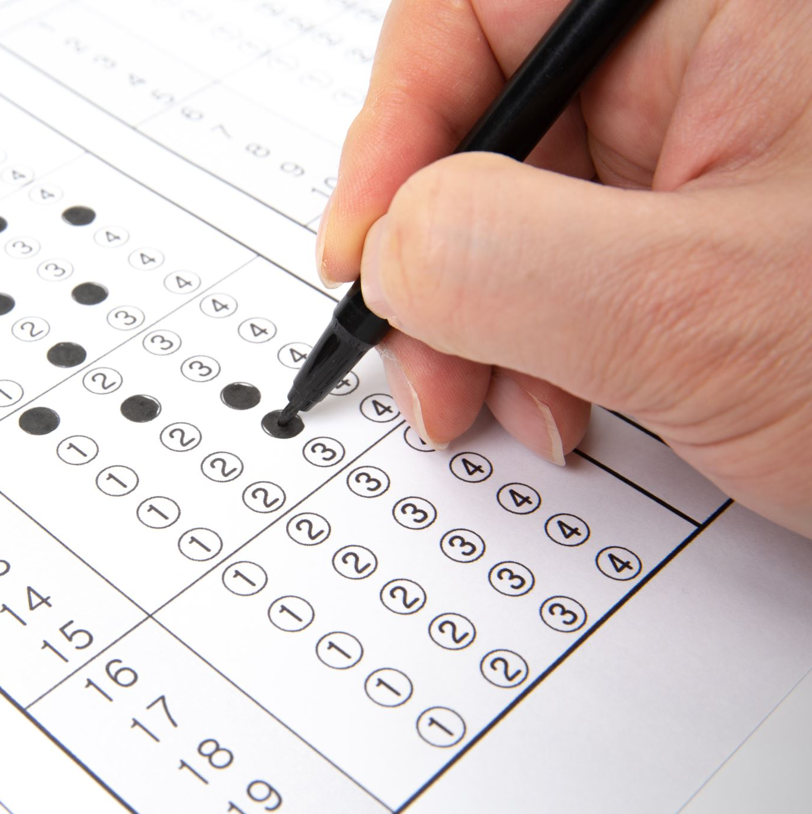
Beginner’s Assessment Test
16 Miⁿókaⁿyìⁿge 2023

Slide 2
1. What is the “you” form of the verb BE?
a. hníⁿ
b. blíⁿ
c. yiⁿ
2. Which is the correct “word order?”
a. object, subject, verb
b. subject, object, verb
c. verb, subject, object
3. What is the “root” for of the verb SEE?
a. Íyaye
b. íye
c. iáye

Slide 3
a. ablíⁿ
b. Shkághe
c. I am a good woman
4. What is the “I’ form of the verb “HAVE?”
a. ablíⁿ
b. ahníⁿ
c. ayíⁿ
5. What is the “you” for the verb MAKE/DO?
a. gághe
b. Shkághe
c. pághe
6. What is the correct translation for “Wak’ó yáli bliⁿ?”
a. she is a good woman
b. you are a good woman
c. I am a good woman

Slide 4
7. What is the correct translation for “You saw five wild horses.”
a. Shóⁿge sátaⁿ máⁿtanahá íyaye
b. Shóⁿge yábliⁿ máⁿtanahá íye
c. Shóⁿge sátaⁿmáⁿtanahá iáye
8. What is the correct translation for “Wanóⁿble pághe akhahé.
a. you want a meal
b. I made a meal
c. you made a meal
9. What is the “you” negative suffix?
a. zhi
b. mazhi
c. azhi

Slide 5
10. What is the “I’ possessive pronoun?
a. wíta
b. íta
c. yíta
11. What is the correct translation for “I want that apple.”
a. shétaⁿga éshki kóⁿbla ayihé
b. shétaⁿga éshki shkóⁿhna ayihé
c. shétaⁿga éshki góⁿya ayihé
12. What is the correct translation for "Shídohìⁿga: Ikó, shétaⁿga kóⁿbla mazhi miⁿkhé"
a. Boy: Grandpa, I don't want the apple
b. Boy: Grandma, I don't want the apple
c. Girl: Grandma, I want the apple
A. WÍTA
a. shétaⁿga éshki kóⁿbla ayihé
b. Boy: Grandma, I don't want the apple

Slide 6
13. What is the correct translation for "Ikó: Miká akhá shétaⁿga góⁿya híⁿe?"
a. Grandpa: The raccoon doesn't want the apple
b. Grandma: Does the buffalo want the apple? yes or no.
c. Grandma: Does the raccoon want the apple? yes or no.
14. What is the correct translation for "Shídohìⁿga: Howé. Miká wíta ahká shétaⁿga wayúta ta akhá"
a. Boy: Yes. My raccoon will work for the apple.
b. Girl: Yes. My raccoon will work for the apple.
c. Boy: No. My raccoon won't work for the apple
15. What is the "I" continuative when you're sitting?
a. Miⁿkhe
b. Hniⁿkhe
c. Akhahé
C
A
A

Slide 7
16. What is the "You" continuative when you're standing?
a. Hniⁿkhé
b. Yakháshe
c. Yayishé
17. What is the "Root" form for the verb WANT/WISH/HOPE FOR?
a. Pághe
b. Kóⁿbla
c. Góⁿya
18. What is the continuative or "spacer" you would use if someone is NOT PRESENT?
a. Akhá
b. Abá
c. Akhahé

Slide 8
c. Óblaska
a. Buffalo Bull
19. What is the word for "PURSE?"
a. Lezé
b. Owíⁿzha
c. Óblaska
20. What is the correct translation for "CEDÓⁿGA?"
a. Buffalo Bull
b. Female Buffalo
c. Buffalo

Slide 9
Verb Conjugation Chart
(Pg. vi in Kaáⁿze Íe Wayáje)
STEM TYPE | PRONOUN PARTICLES
 | I | You | We
<A> | a- | ya-
<B> | p- | shp-
<D> | t- | sht-
<G> | p- | shk-
<G² > | k- | shk-
<H> | ph- | shp-
<Y> | bl- | hn-
<’> | m- | zh-
<S> | aⁿ- | yi-

Slide 10
EXAMPLE:
Pg. 46 in Kaáⁿze Íe Wayáje
dáble [dá__ble] vi <A> hunt, go on a hunt Ye icóshpa
akhá dáble ayé hnáⁿbe. This grandchild of hers
always went hunting. CT.30.2 Dáble ahí akhá. He
went hunting. Dáble ahíbe. He hunted. Dáble ayé
ta abá eyaó. They will be going to hunt. (male
speaking) JOD Dáble blé ta miⁿkhé ao. I will be
going to hunt. (male speaking) JOD Dáble phí e. I
went hunting. (female speaking) MR on JOD
Máⁿhiⁿ Táⁿga wahótⁿ itá aⁿyúzabe ejíkhaⁿ
dáblabe ejíkhaⁿ síka shke ts'eáⁿyabe. From the
time that we received guns from the Americans, we
killed wild turkeys when we hunted the larger
species of game. CT.9.10 Níkashìⁿga dóba dáble
aⁿgáyabe ao. Four of us went hunting, away from
our families. CT.17.1 ♦ JOD: To go hunting the
larger animals, as men do, without taking their
families. ► I- dáable, you- dáyable, he/she/it- dáble
we- aⁿdáblabe, you (pl) dáyablabe, they- dáblabe

Slide 11
Tense | Condition | Continuative
“I” Tense | Moving | Ayíhe
“I” Tense | Standing | Akhahé
“I” Tense | Sitting | Miⁿkhé
“You” Tense | Moving | Yayíshe
“You” Tense | Standing | Yakháshe
“You” Tense | Sitting | Hniⁿkhé
S(H)e/It |  | Abá
 |  | Akhá

